Slide 1
Model simulations
Jan 2024

Slide 2
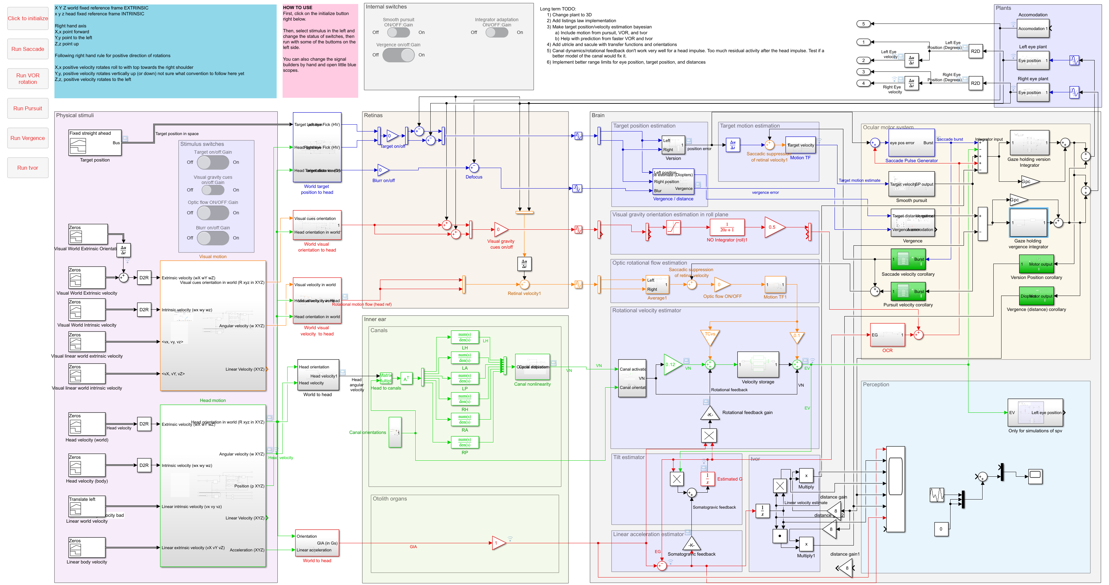

Slide 3
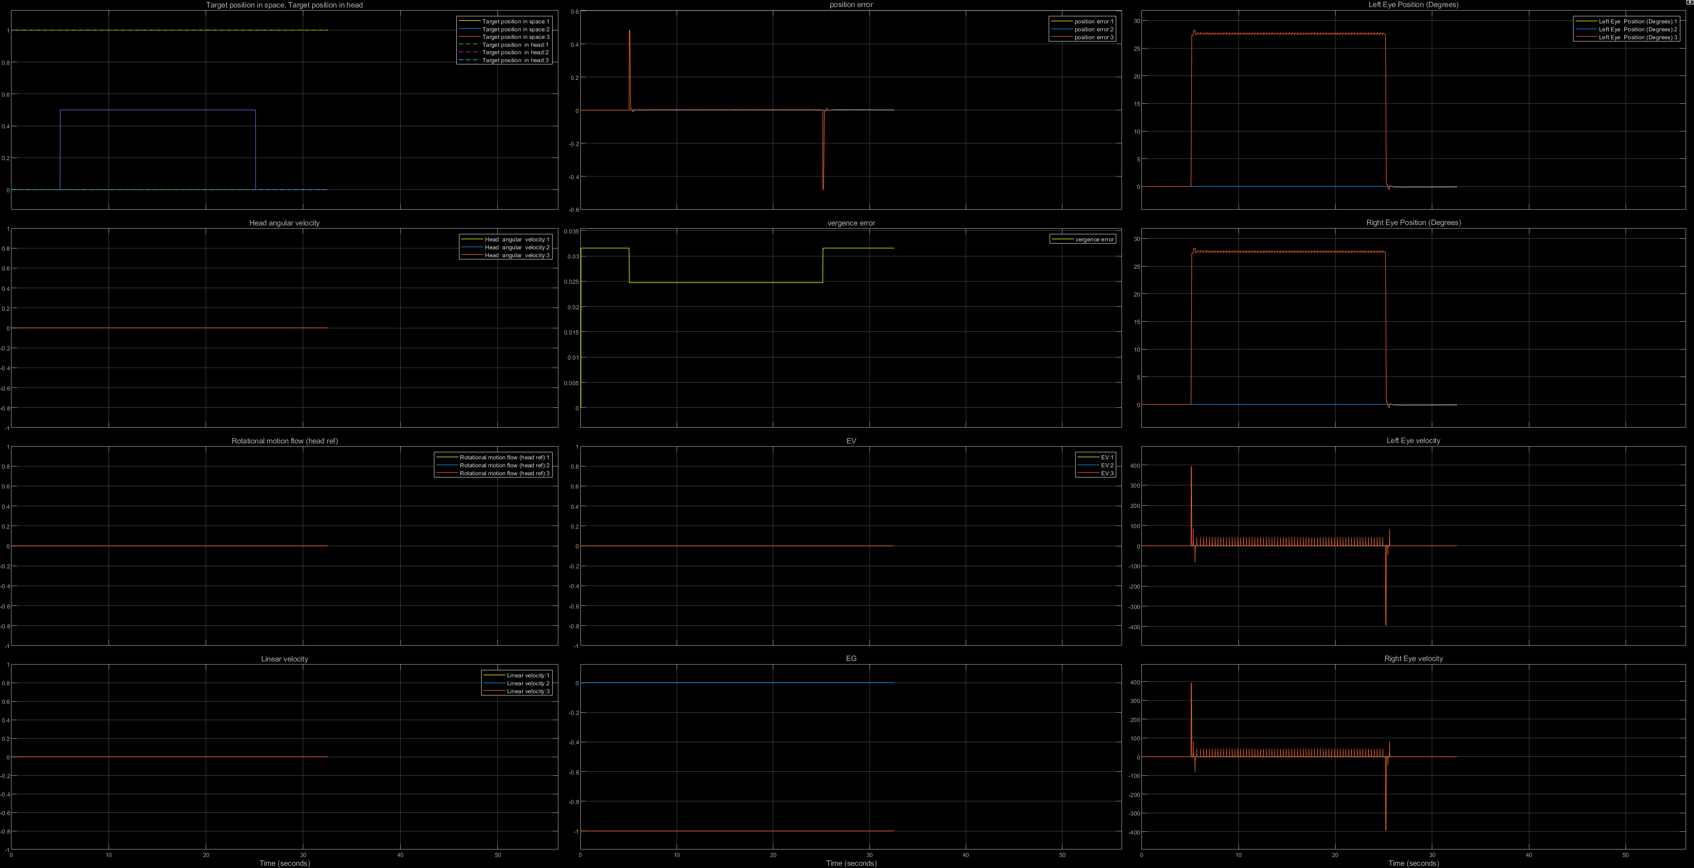
Saccade to flashing target in the dark

Slide 4
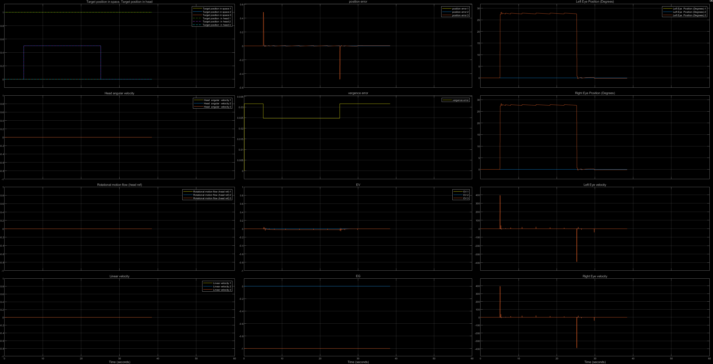
Saccade to flashing target in the light (OKN on)

Slide 5
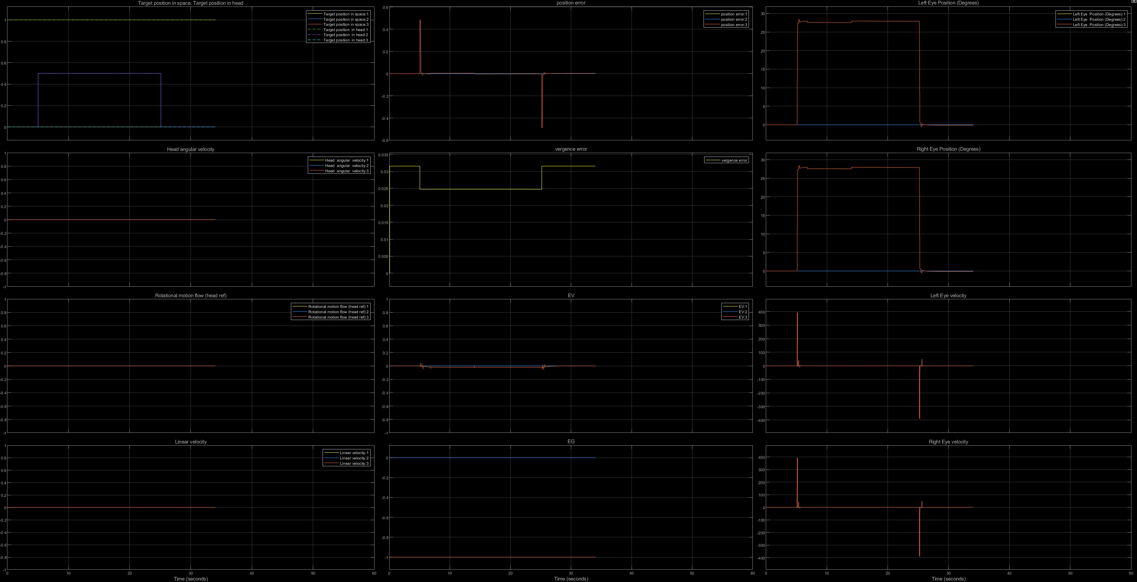
Saccade to flashing fixed in the light (OKN on, pursuit on)

Slide 6
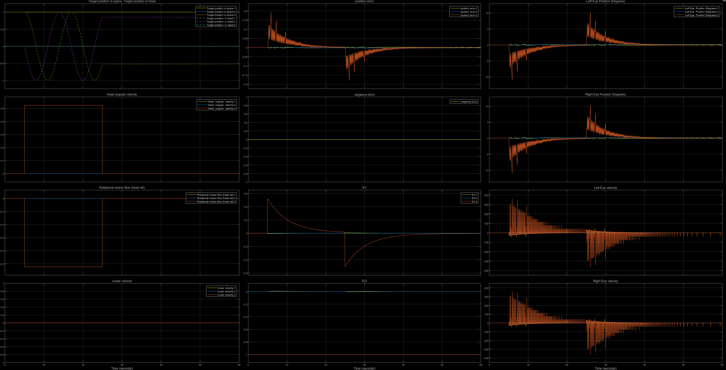
VOR in the dark constant velocity

Slide 7
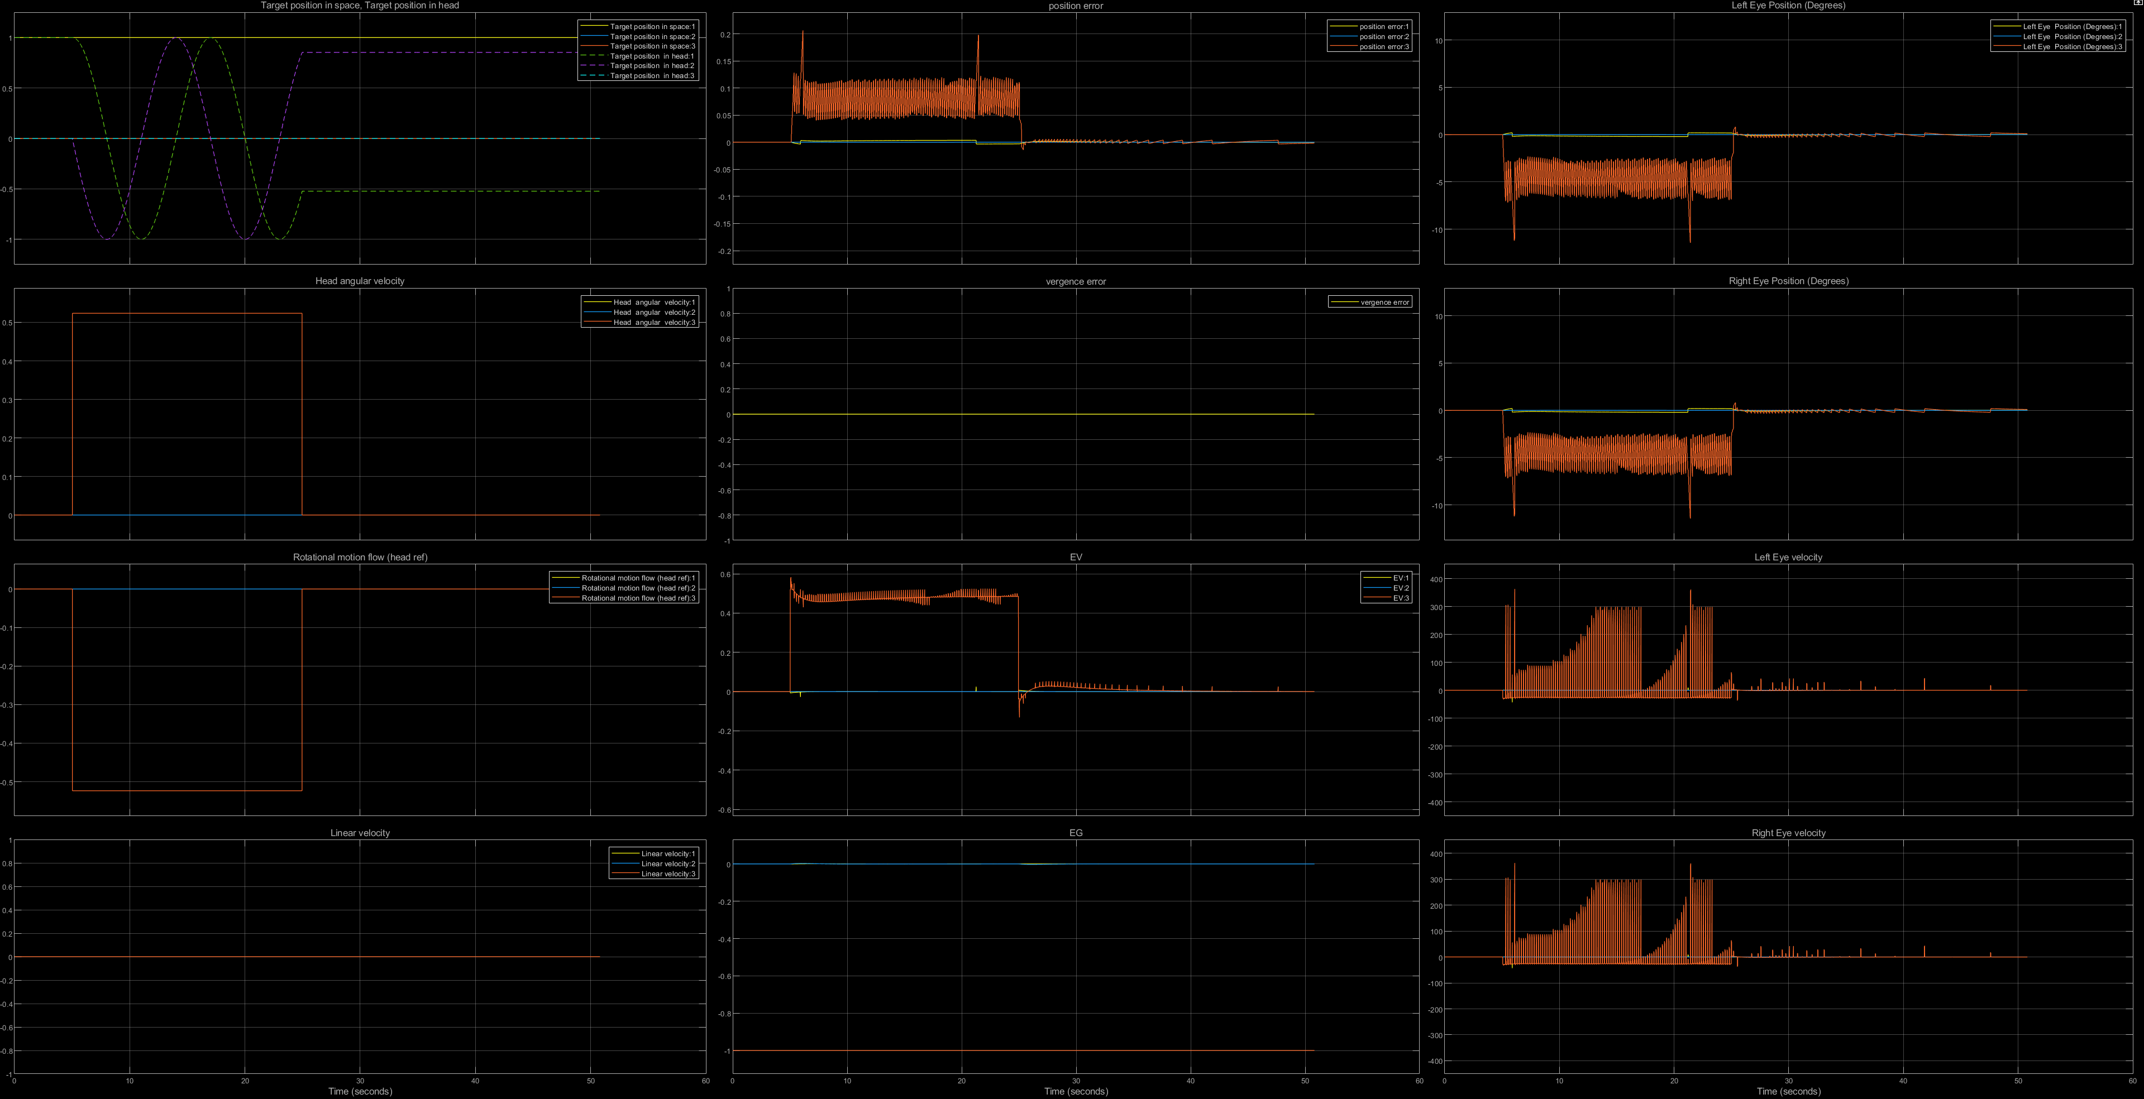
VOR +OKN in the dark constant velocity

Slide 8
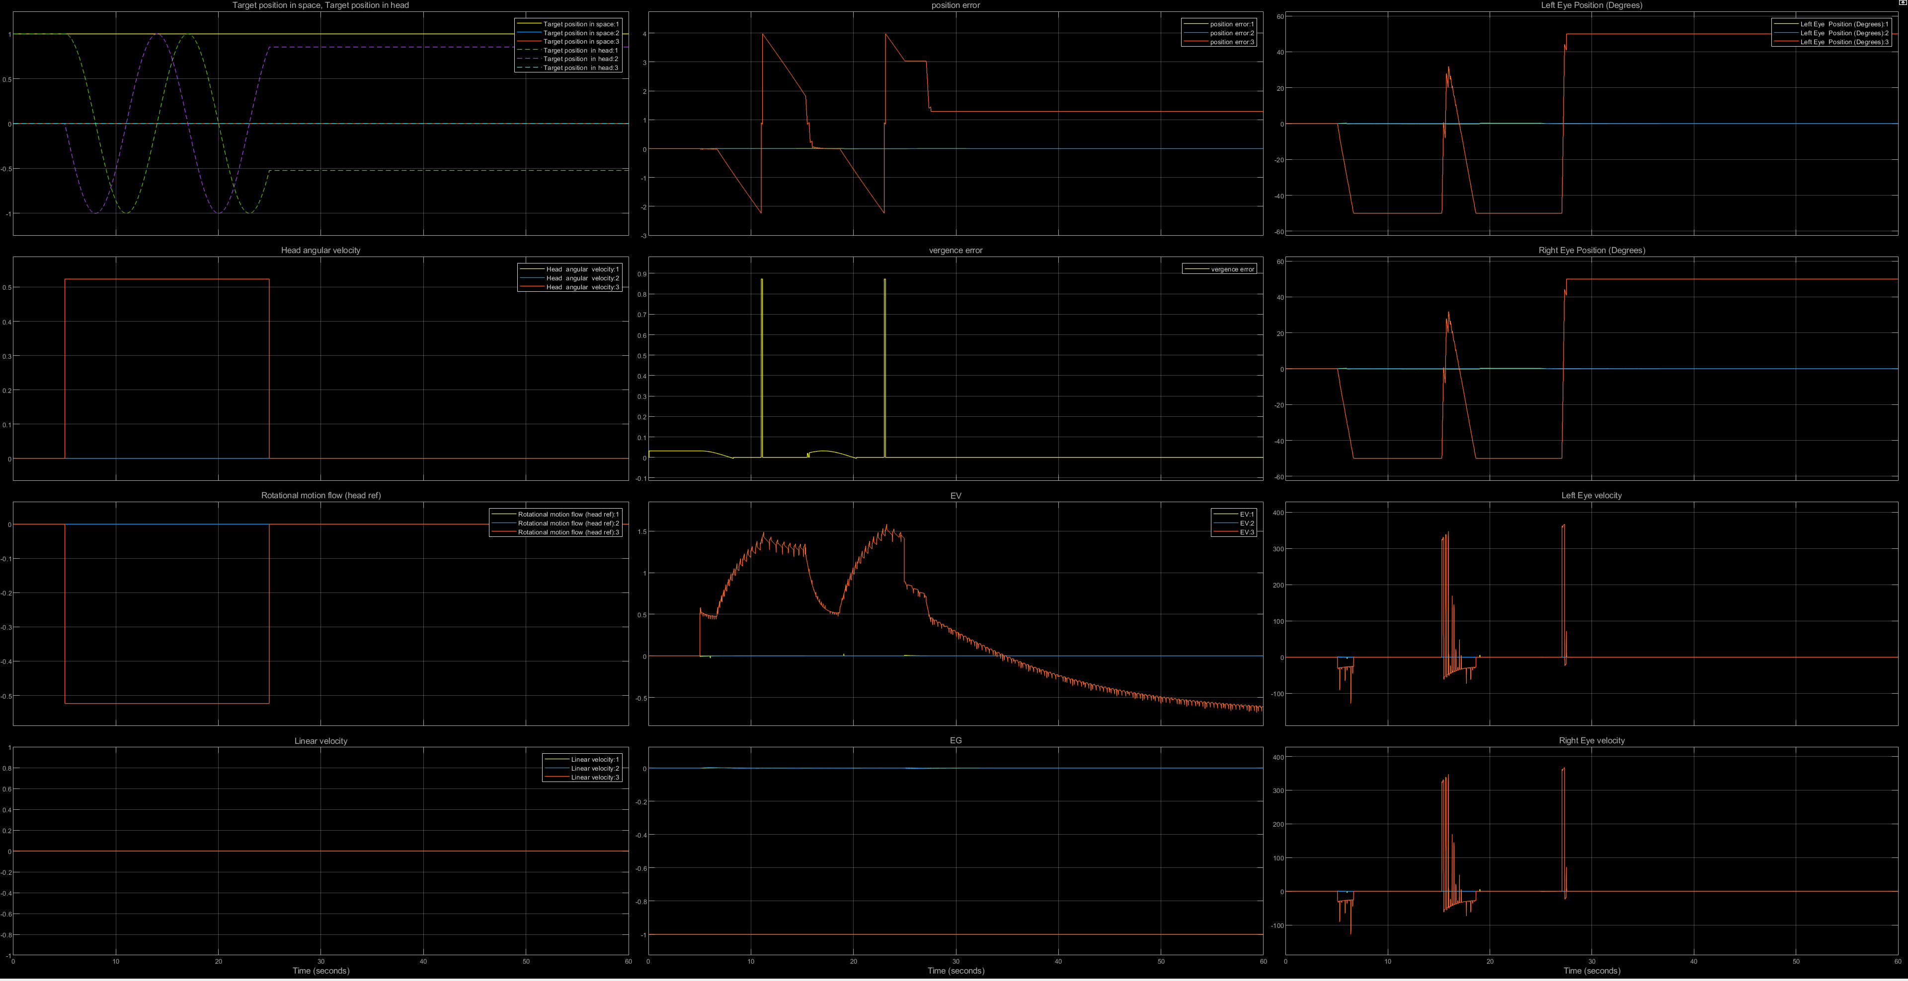
VOR +OKN with a fixation target constant velocity

Slide 9
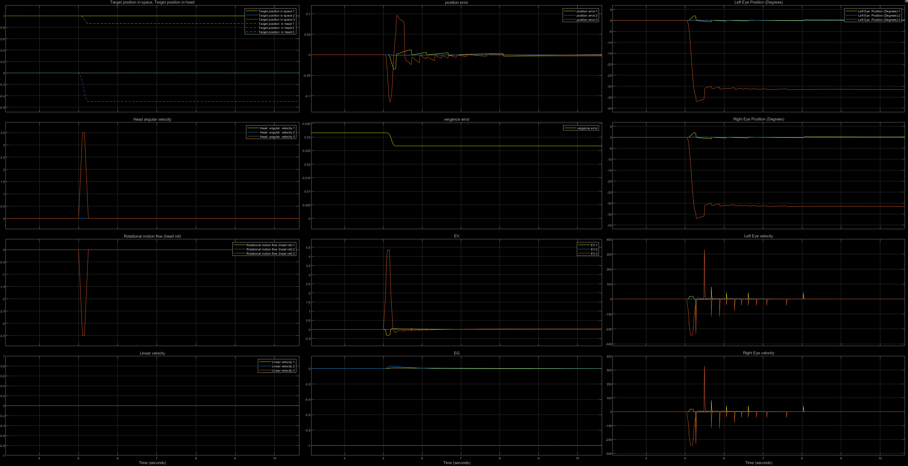
VOR +OKN with a fixation target head impulse

Slide 10
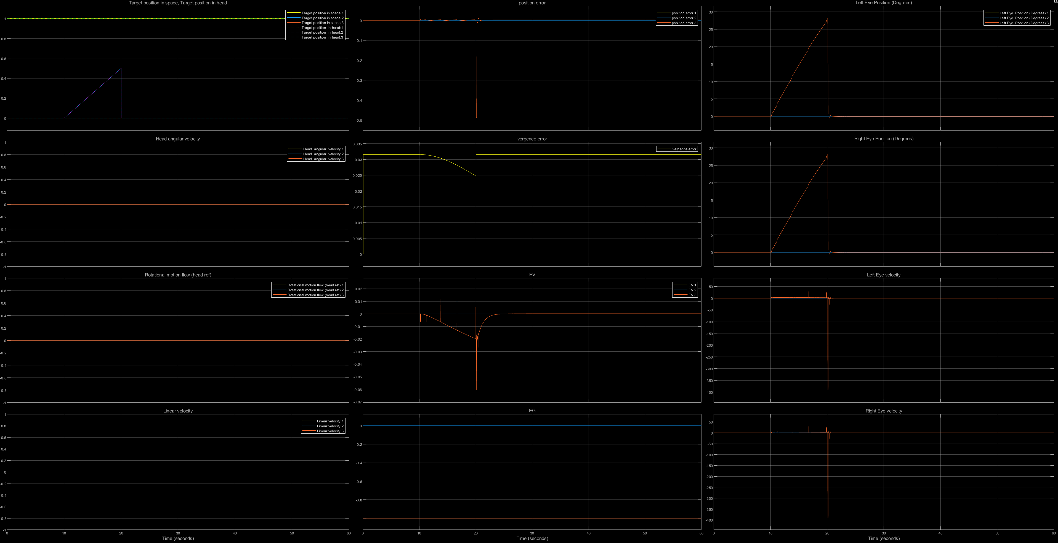
Pursuit of constant velocity target (OKN on)

Slide 11
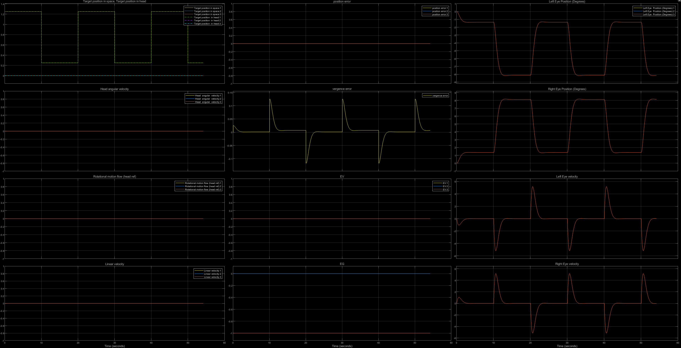
Vergence back and forth

Slide 12
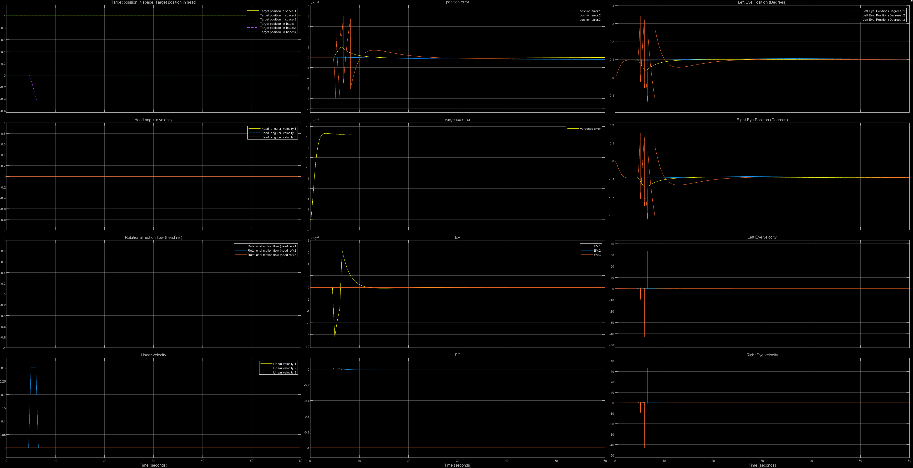
Tvor horizontal

